Slide 1
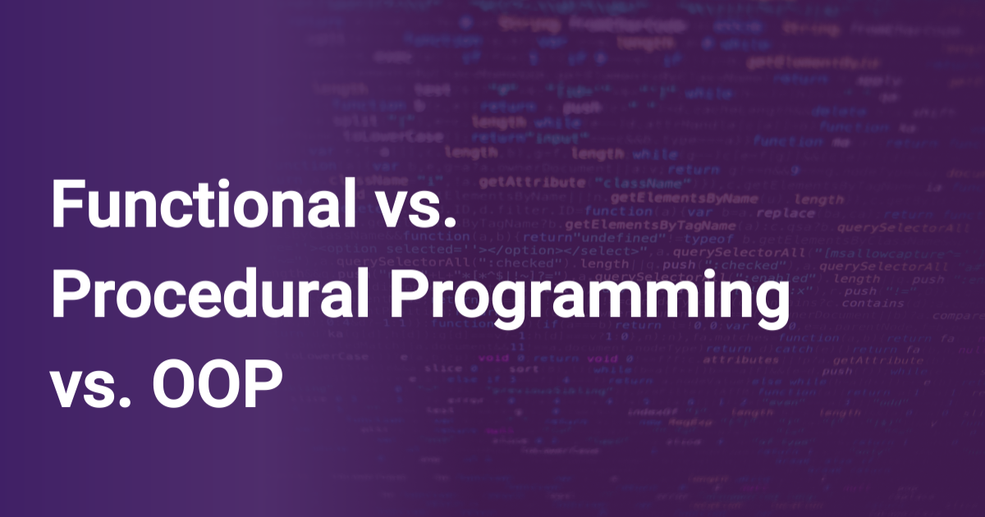

Slide 2
What is a Programming Paradigm?
Programming paradigms are different ways or styles in which a given program or programming language can be organized. Each paradigm consists of certain structures, features, and opinions about how common programming problems should be tackled.

Slide 3
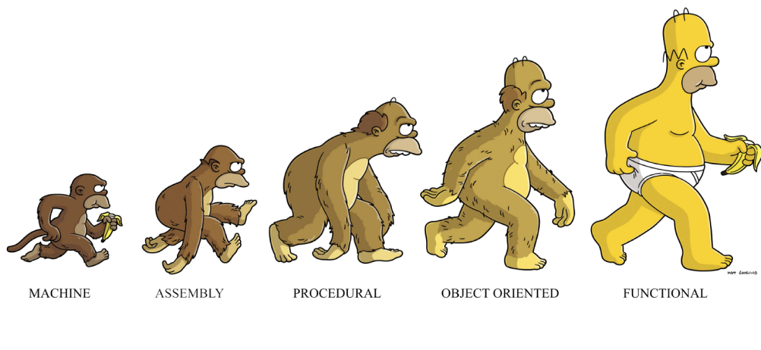

Slide 4
Programming languages aren't always tied to a specific paradigm.
There are languages that have been built with a certain paradigm in mind and have features that facilitate that kind of programming more than others (Haskel and functional programming is a good example).
But there are also "multi-paradigm" languages, meaning you can adapt your code to fit a certain paradigm or another (JavaScript and Python are good examples).

Slide 5

Why should I care?
Exploring these topics is a good way of opening your mind and helping you think outside the box and outside the tools you already know.
Moreover, these terms are used a lot in the coding world, so having a basic understanding will help you better understand other topics as well.

Slide 6
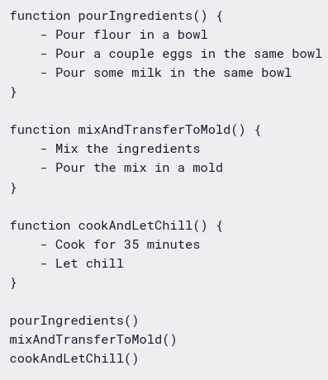
Procedural Programming
Procedural programming is a derivation of imperative programming. In procedural programming, the user is encouraged to subdivide the program execution into functions, as a way of improving modularity and organization.
Following our cake example,
procedural programming may look like this:
You can see that, thanks to the implementation of functions, we could just read the three function calls at the end of the file and get a good idea of what our program does.

Slide 7
Imperative Programming
Imperative programming consists of sets of detailed instructions that are given to the computer to execute in a given order. It's called "imperative" because as programmers we dictate exactly what the computer has to do, in a very specific way.
Imperative programming focuses on describing how a program operates, step by step.
const nums = [1,4,3,6,7,8,9,2]
const result = []
for (let i = 0; i < nums.length; i++) {
if (nums[i] > 5) result.push(nums[i])
}
console.log(result) // Output: [ 6, 7, 8, 9 ]
1- Pour flour in a bowl
2- Pour a couple eggs in the same bowl
3- Pour some milk in the same bowl
4- Mix the ingredients
5- Pour the mix in a mold
6- Cook for 35 minutes
7- Let chill

Slide 8
Functional Programming
Functional programming takes the concept of functions a little bit further.
In functional programming, functions are treated as first-class citizens, meaning that they can be assigned to variables, passed as arguments, and returned from other functions.
Another key concept is the idea of pure functions. A pure function is one that relies only on its inputs to generate its result. And given the same input, it will always produce the same result. Besides, it produces no side effects (any change outside the function's environment).

Slide 9
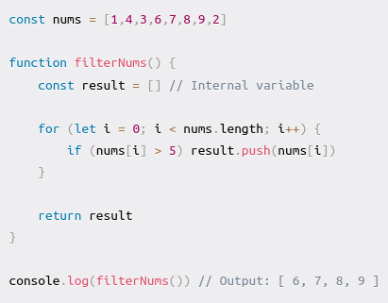
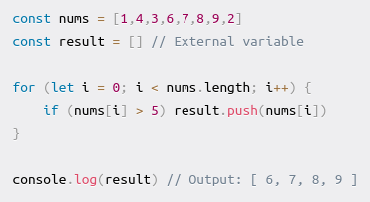
Before:
After:

Slide 10
Declarative Programming
Declarative programming is all about hiding away complexity and bringing programming languages closer to human language and thinking. It's the direct opposite of imperative programming in the sense that the programmer doesn't give instructions about how the computer should execute the task, but rather on what result is needed.
const nums = [1,4,3,6,7,8,9,2]
const result = [] // External variable
for (let i = 0; i < nums.length; i++) {
if (nums[i] > 5) result.push(nums[i])
}
console.log(result) // Output: [ 6, 7, 8, 9 ]
const nums = [1,4,3,6,7,8,9,2]
console.log(nums.filter(num => num > 5)) // Output: [ 6, 7, 8, 9 ]

Slide 11
Object-Oriented Programming
One of the most popular programming paradigms is object-oriented programming (OOP).
The core concept of OOP is to separate concerns into entities which are coded as objects. Each entity will group a given set of information (properties) and actions (methods) that can be performed by the entity.
OOP makes heavy usage of classes (which are a way of creating new objects starting out from a blueprint or boilerplate that the programmer sets). Objects that are created from a class are called instances.
Following our pseudo-code cooking example, now let's say in our bakery we have a main cook (called Frank) and an assistant cook (called Anthony) and each of them will have certain responsibilities in the baking process. If we used OOP, our program might look like this.

Slide 12


